Slide 1
NEERAJ EXIM ENTERPRISES
OFFICE & WORKS ADDRESS:
746/4/A, GIDC INDUSTRIAL ESTATE
EPOXY HOUSE LANE, MAKARPURA
VADODARA-390010
GUJARAT, INDIA
Mobile : +91 9824260565 / +91 7698493390

Slide 2
PROFILE
Incepted in 2001, our company manufactures components and assemblies for numerous range of industries and exports them to Europe (The Netherlands, Sweden, Spain, France and Hungary), Qatar, Australia, Canada and USA. The proprietor Mr. Daulat R Brahmkhatri, a BE Mechanical Engineering graduate and diploma in export import management has over 40 years of experience in field of manufacturing and sourcing of engineering products in various fields like Sheet metal parts, Deep Drawn components, Fabricated assemblies / subassemblies and Machined Components.

Slide 3
We have a CNC Turning and Machining facility where we have built-up capacity to manufacture Precision Turned and Machined Components from various types of metals. Depending upon the type of part and operations required, we have capacity to program and obtain accuracy in microns. In addition, we also have conventional machines such as milling, shaping, centre-less grinder, Tool & Cutter grinder and deburring barrels.

Slide 4
We are registered as small scale industry with District Industries Commissioner and also with GST authorities as manufacturers. We are also registered with DGFT (Director General Of Foreign Trade) and FIEO (Federation of Indian Exporters’ Organisation) for Import and Export. Our company details with various enrolment numbers are given at a later stage in this profile.

Slide 5
We have all the necessary measuring instruments to measure dimensions to the required accuracies and a high level of inspection confidence has been developed on the customers side. We carry out both in-process and final inspection. We regularly maintain the measuring Instruments and also get them calibrated at regular intervals.

Slide 6
We have excellent facilities to manufacture your requirement of:
Turned Components
CNC Machined Components
Parts for assemblies and
Custom made fasteners

Slide 7
We manufacture machined parts from following metals (rods and pipes):
Carbon Steels / Mild Steel
Stainless Steels
Brass
Copper
Aluminum
Various Plastics

Slide 8
Our products used in different Industries such as these:
Hospital Furniture and Accessories
Hospital Equipment
Instruments for ships
Mobile Traffic Systems
Hardware Industries Products
Tents, Scaffoldings and Structures
Garden accessories products
Sewage Treatment Plants
Oil & Gas Industries Equipment

Slide 9
Following facilities are available around our factory which can be availed for making parts:
Shaping
Milling
Drilling
Grinding
Turning
CNC Machining
Heat Treatment

Slide 10
List of Machineries is as under:
CNC Turning Centers. …8 Nos.
Super-cut 5, Super-cut-6 (PMT India make)
Automatic and Semi automatic Traub of various makes .. 12 Nos.
(Die range 1 mm to 60 mm)
CNC Turning Center (HAAS USA MAKE) .. 5 Nos.
Centre-less Grinder suitable for 35 mm Dia.
Vertical Machining Centre (HAAS USA Make).. 3 nos.
(MODEL VF-2, CAPACITY 762 L X 410 X 500 MM)
Lathe machines…5 Nos.
Vibratory Deburring & Polishing Machine
Drilling Machines and Small Lathes
Tool and Cutter Grinder

Slide 11
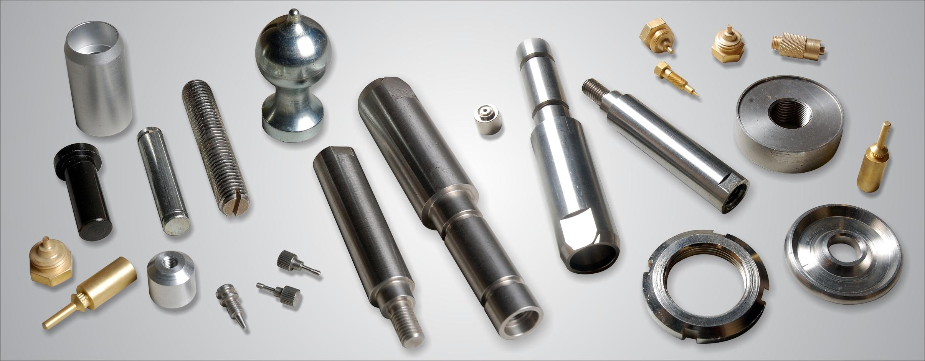
Pictures of some of the CNC Machined components developed:

Slide 12
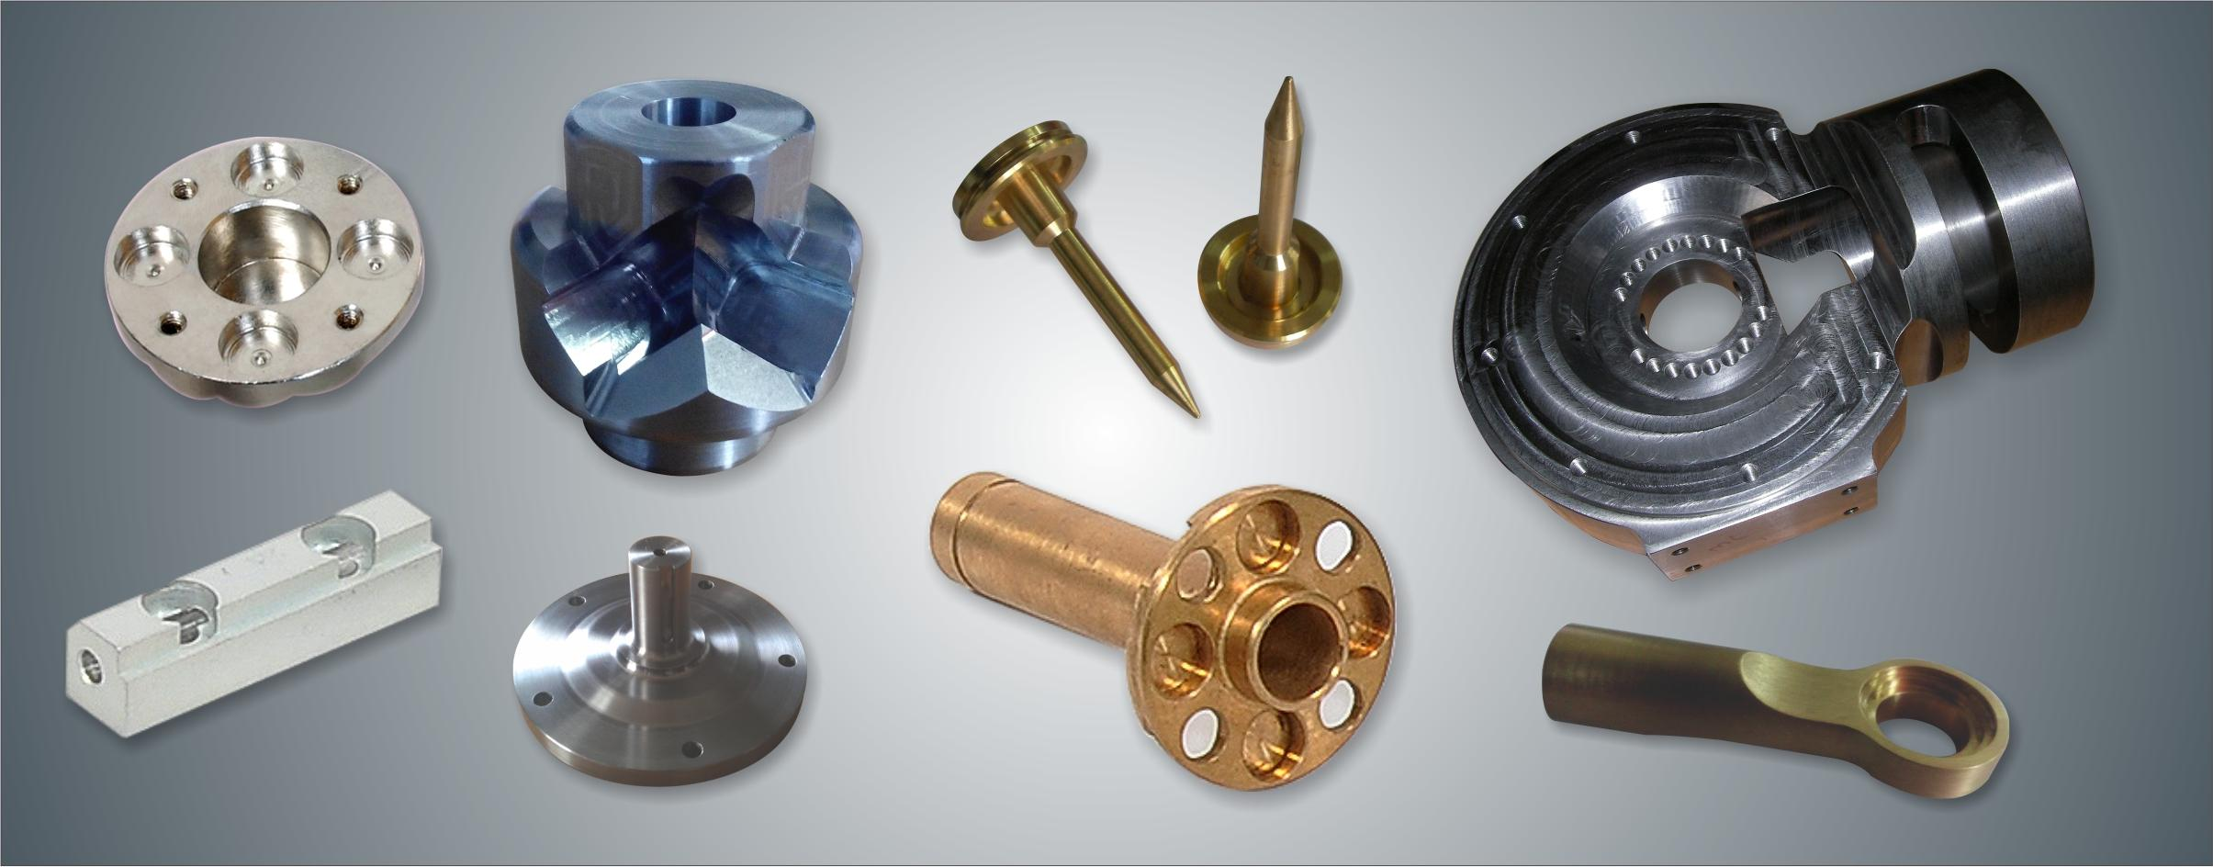
Pictures of some of the CNC Machined components developed:

Slide 13
COMPANY INFORMATION:
No. of employees working: Administrative: 8 persons
Workshop & Inspection : 20 persons
Our company website: www.neerajexim.com
Email id: drbkhatri@neerajexim.com
niraj@neerajexim.com
Contact : Daulat R Brahmkhatri, Proprietor
Niraj D Brahmkhatri, Export Manager
Mobile No: +91 9824260565/+91 7698493390

Slide 14
COMPANY DETAILS:
GST Registration No….. 24AALPB4788M1Z9
Importer Exporter Code (IEC)…..3402002850
D & B DUNS NO: 86-453-5667

Slide 15
CERTIFICATIONS:
NEERAJ EXIM ENTERPRISES
Manufacture and Export of Mechanical Components and Fabricated assemblies for Industrial Use.
ISO 9001:2015
Quality Management Systems

Slide 16
PROFESSIONAL MEMBERSHIPS:
1. Vadodara Chamber of Commerce and Industry (VCCI)
GIDC Industrial Estate, Makarpura
Vadodara, Gujarat, India.
2. Federation of Indian Export Organisations
(F.I.E.O.)
Times Square
Andheri-Kurla Road,
Andheri, Mumbai 400 059.

Slide 17
BANKERS:
1. IDBI Bank Limited
1st Floor, Garg Plaza, 46-A,
Gautam Nagar, Near MGVCL Building,
Race Course Road, Baroda 390 007, Gujarat.
2. ICICI Bank Limited
Landmark Building,
Race Course Circle Road, Alkapuri,
Baroda 390 015, Gujarat

