Slide 1
NEERAJ EXIM ENTERPRISES
OFFICE & WORKS ADDRESS:
746/4/A, GIDC INDUSTRIAL ESTATE
EPOXY HOUSE LANE, MAKARPURA
VADODARA-390010
GUJARAT, INDIA
Mobile : +91 9824260565 / +91 7698493390

Slide 2
PROFILE
Incepted in 2001, our company manufactures components and assemblies for numerous range of industries and exports them to Europe (The Netherlands, Sweden, Spain, France and Hungary), Qatar, Australia, Canada and USA. The proprietor Mr. Daulat R Brahmkhatri, a BE Mechanical Engineering graduate and diploma in export import management has over 40 years of experience in field of manufacturing and sourcing of engineering products in various fields like Sheet metal parts, Deep Drawn components, Fabricated assemblies / subassemblies and Machined Components.

Slide 3
We have a Sheet Metal facility where we have built-up capacity to manufacture Sheet Metal Components, Press Parts and Deep drawn components. Depending upon the type of part, we have capabilities to make dies and tools for Blanking, piercing, punching, bending, forming, deep drawing, shaving, dimple forming, and so on. We have Power and Hydraulic Presses from 5 tons capacity to 250 tons. In addition, we also have Shearing machines, Press Brakes, Spot Welding machines, MIG and TIG Welding Machines and deburring barrels.

Slide 4
Depending on the part requirement, we can develop Compound or Progressive dies to meet quantity and quality requirements.
We are registered as small scale industry with District Industries Commissioner and also with GST authorities as manufacturers. We are also registered with DGFT (Director General Of Foreign Trade) and FIEO (Federation of Indian Exporters’ Organization) for Import and Export. Our company details with various enrolment numbers are given at a later stage in this profile.

Slide 5
Our Inspection Department is equipped with all the necessary Measuring Instruments to measure dimensions to the required accuracies and a high level of inspection confidence has been developed on the customers side. We carry out both in-process and final inspection. We regularly maintain the measuring Instruments and also get them calibrated at regular intervals.

Slide 6
We manufacture Sheet Metal Parts from following metals:
Carbon Steels / Mild Steel
Stainless Steels
Brass
Copper
Aluminum
Spring Steel

Slide 7
Our products are used in different Industries such as the following:
Hospital Furniture and Accessories
Hospital Equipment
Instruments for ships
Mobile Traffic Systems
Hardware Industries Products
Tents, Scaffoldings and Structures
Garden accessories products
Sewage Treatment Plants
Oil & Gas Industries Equipment

Slide 8
Following facilities are available around our factory to make Tooling and Special Parts:
Turret Punching
Laser cutting
Plasma cutting
Gas cutting
EDM wire-cutting
Heat Treatment
Powder Coating and Electroplating
Electroless Plating
Hot Dip Galvanizing

Slide 9
List of Machinery is as under:
Power Presses from 5 tons to 250 tons. …8 Nos.
Hydraulic Presses up to 150 tons. ..2 Nos.
Double action deep draw Presses up to 150 tons. 3 Nos.
Press Brake…10 ft.
Shearing machine….10 ft.
TIG / MIG welding Machine….3 Nos.
Surface Grinder
Spark Erosion Machine
Milling machine
Shaping machine
Lathe machines…5 Nos.
Vibratory Deburring & Polishing Machine

Slide 10
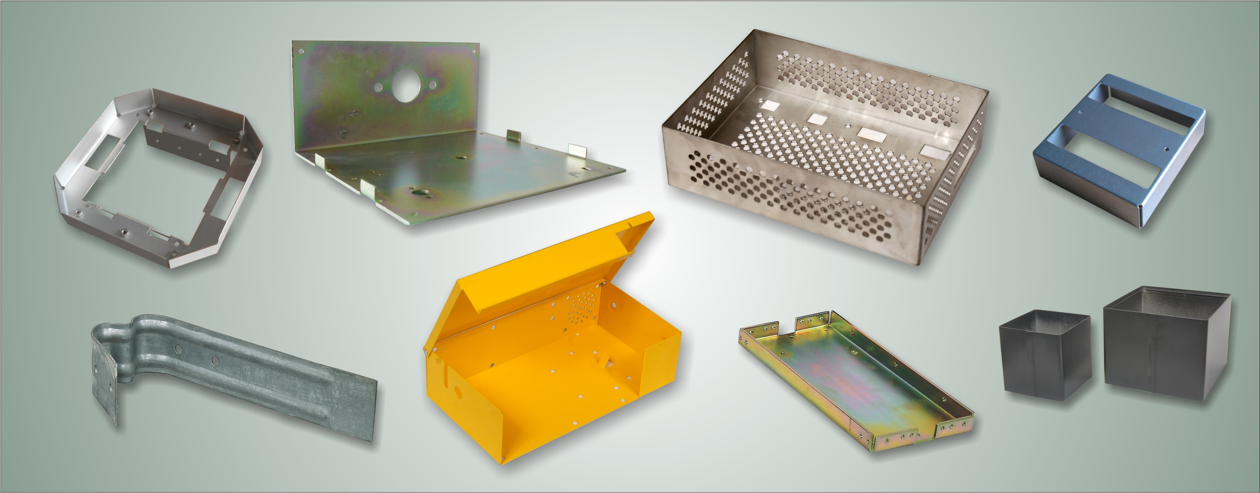
Pictures of some of the Deep Drawn and Press components developed:

Slide 11
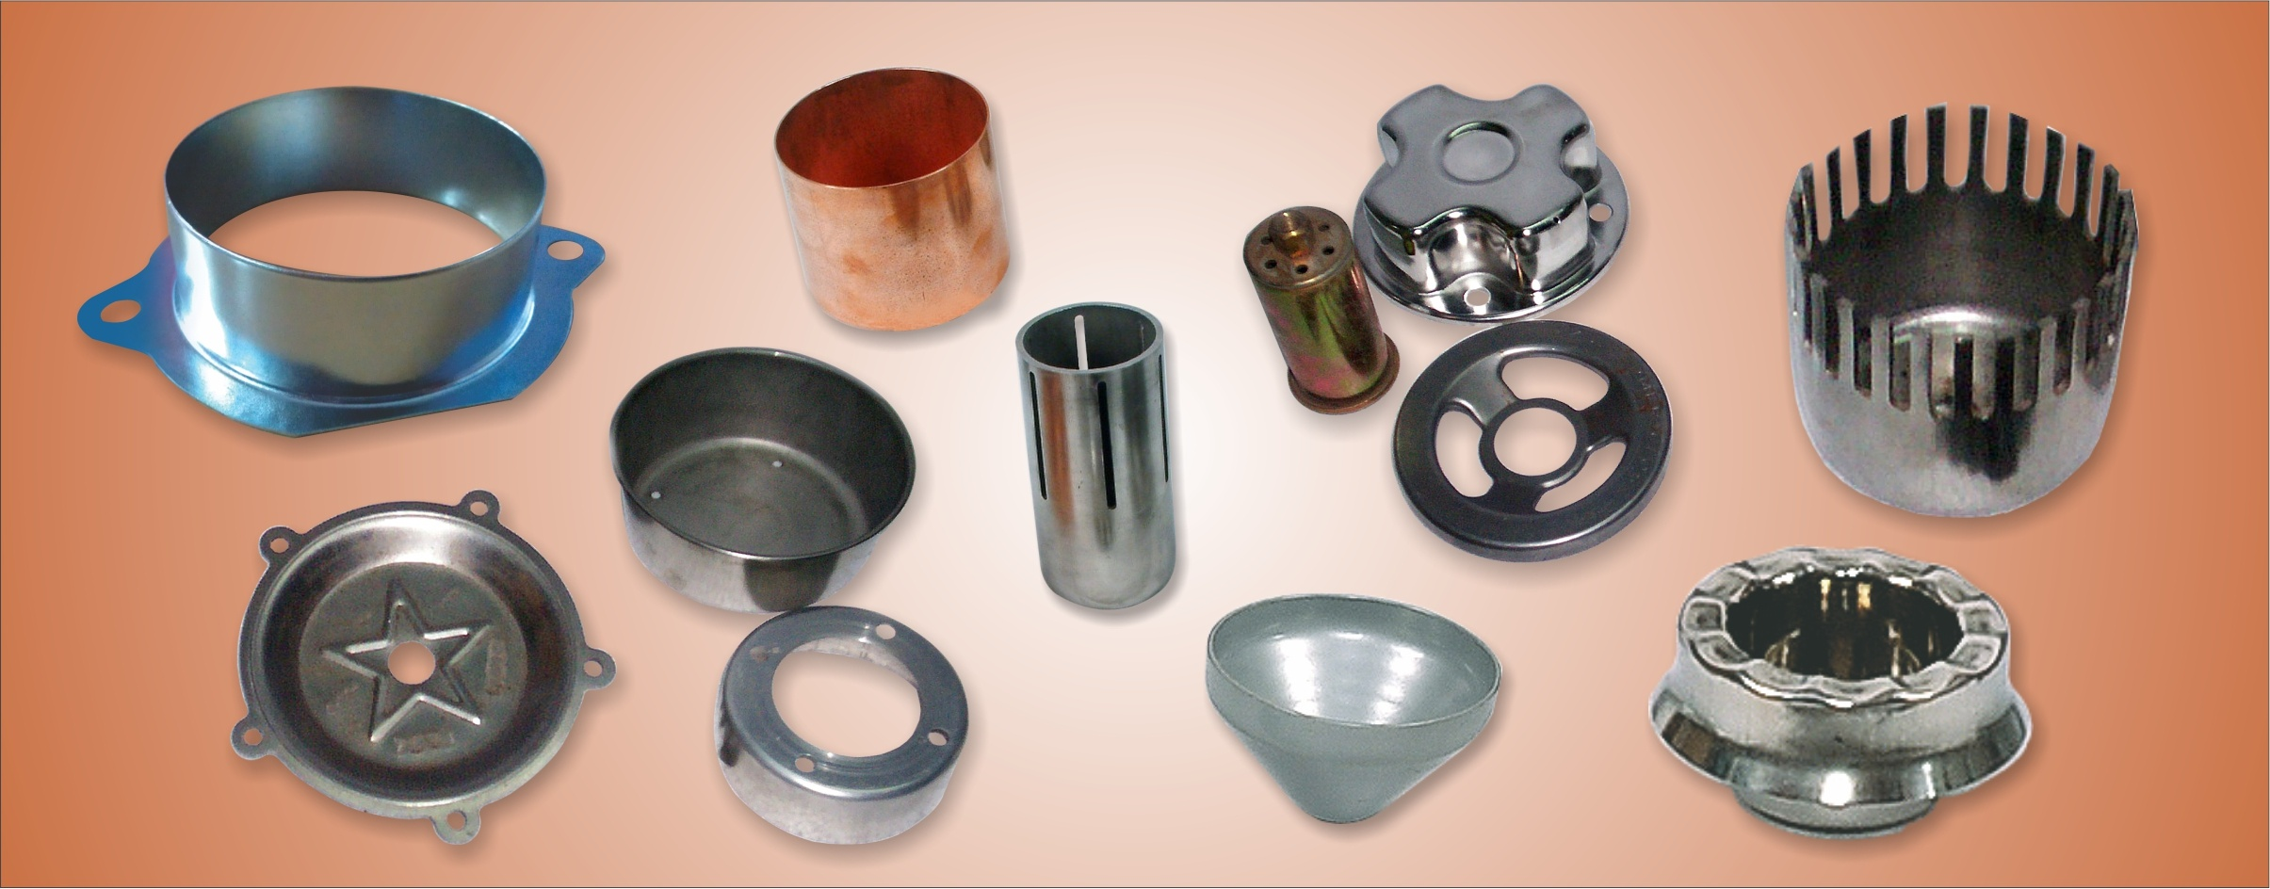
Pictures of some of the Deep Drawn and Press components developed:

Slide 12
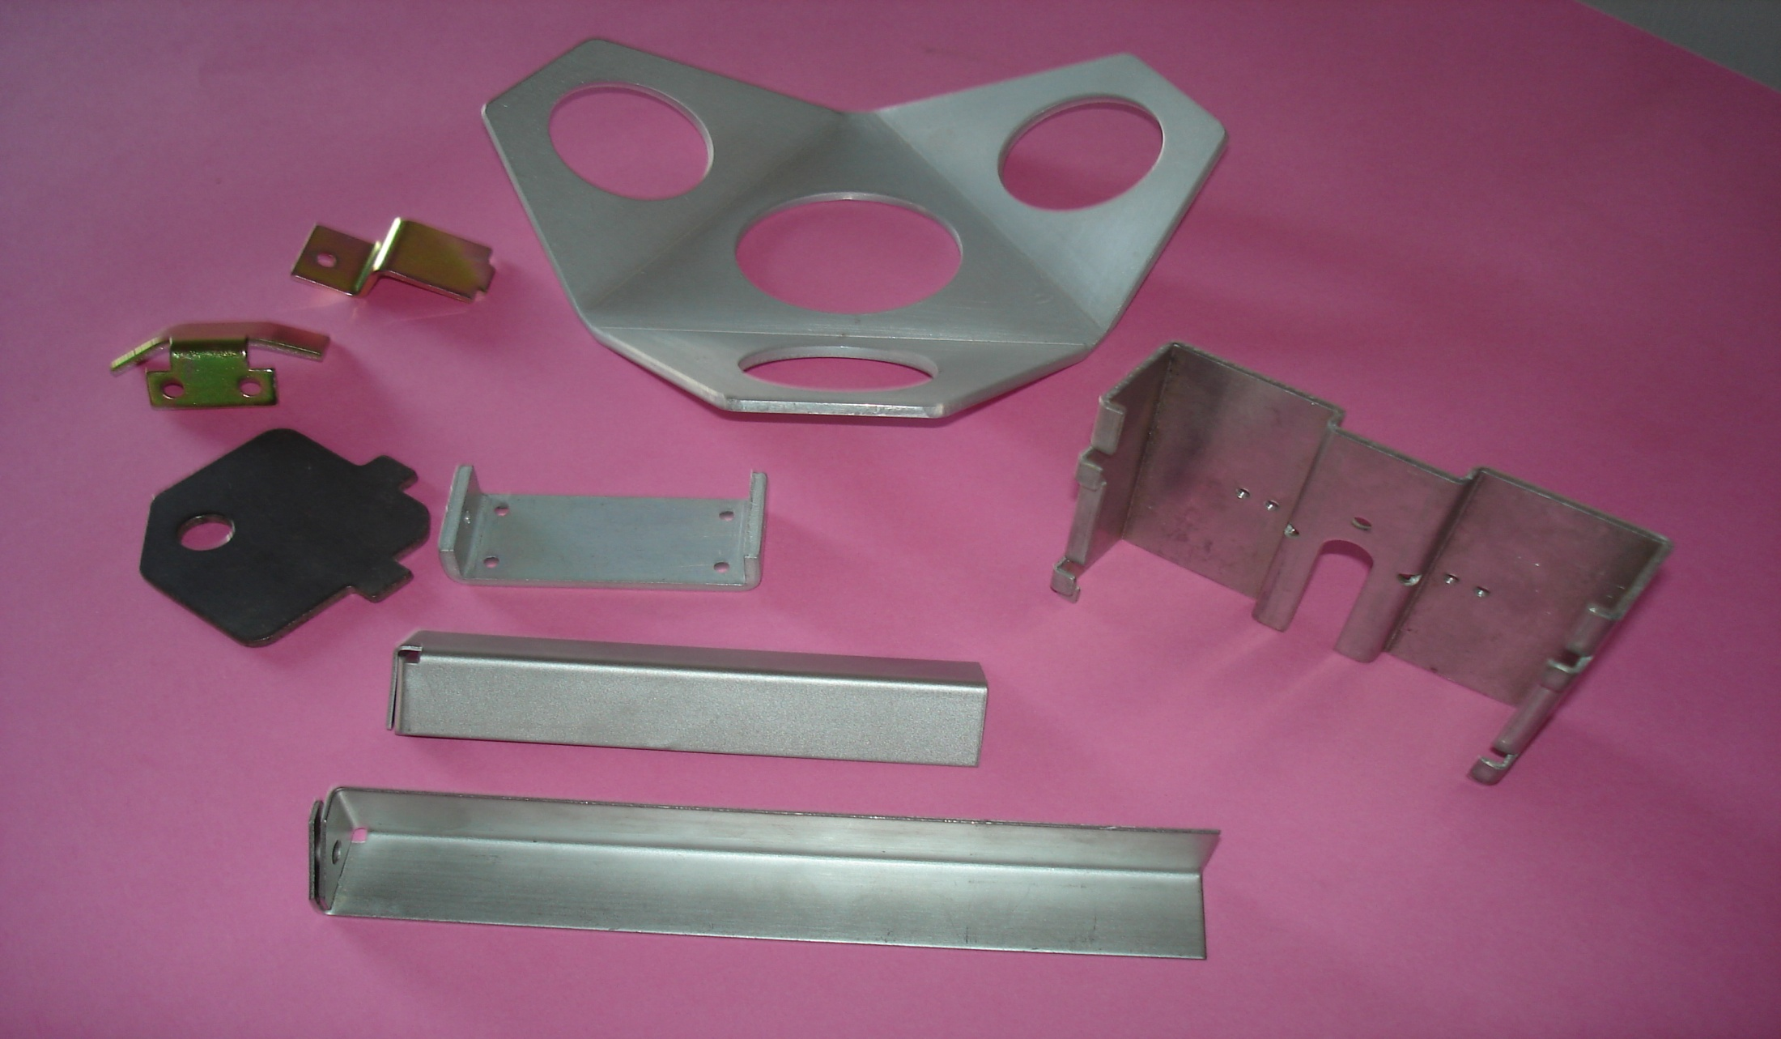
Pictures of some of the Deep Drawn and Press components developed:

Slide 13
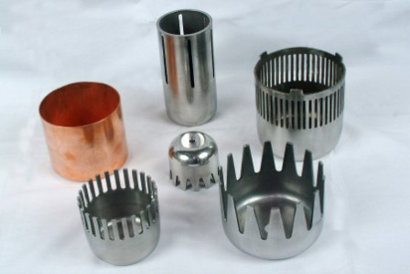
Pictures of some of the Deep Drawn and Press components developed:

Slide 14
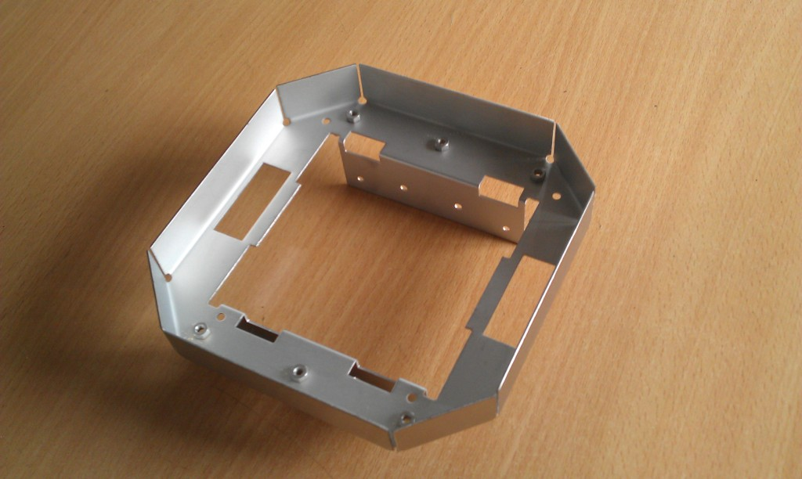
Pictures of some of the Deep Drawn and Press components developed:

Slide 15
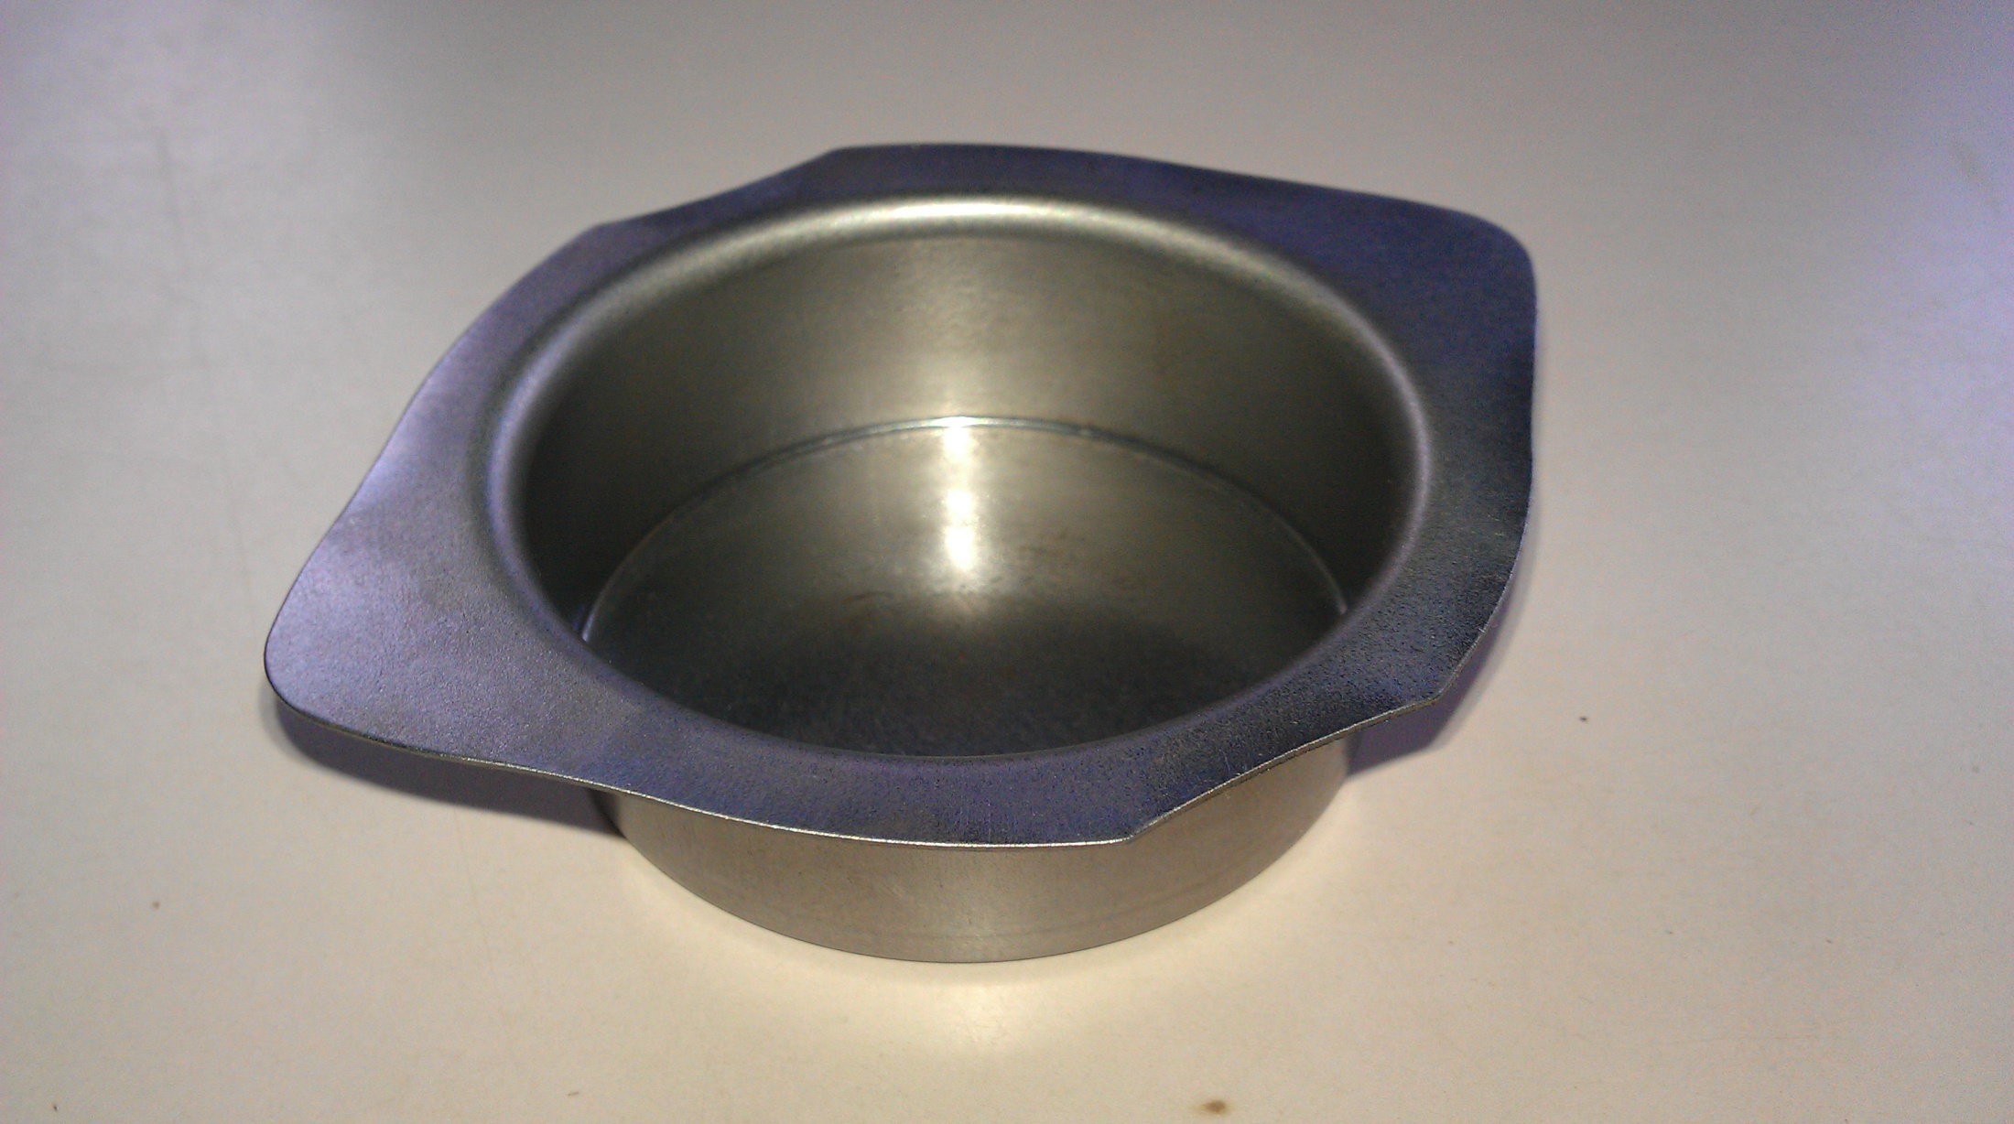
Pictures of some of the Deep Drawn and Press components developed:

Slide 16
COMPANY INFORMATION:
No. of employees working: Administrative: 8 persons.
Workshop & Inspection : 15 persons.
Our company website: www.neerajexim.com
Email id: drbkhatri@neerajexim.com
niraj@neerajexim.com
Contact : Daulat R Brahmkhatri, Proprietor
Niraj D Brahmkhatri, Export Manager
Mobile No: +91 9824260565/+91 7698493390

Slide 17
COMPANY DETAILS:
GST Registration No….. 24AALPB4788M1Z9
Importer Exporter Code (IEC)…..3402002850
D & B DUNS NO: 86-453-5667

Slide 18
CERTIFICATIONS:
NEERAJ EXIM ENTERPRISES
Manufacture and Export of Mechanical Components and Fabricated assemblies for Industrial Use.
ISO 9001:2015
Quality Management Systems

Slide 19
PROFESSIONAL MEMBERSHIPS:
1. Vadodara Chamber of Commerce and Industry (VCCI)
GIDC Industrial Estate, Makarpura
Vadodara, Gujarat, India.
2. Federation of Indian Export Organisations
(F.I.E.O.)
Times Square
Andheri-Kurla Road,
Andheri, Mumbai 400 059.

Slide 20
BANKERS:
1. IDBI Bank Limited
1st Floor, Garg Plaza, 46-A,
Gautam Nagar, Near MGVCL Building,
Race Course Road, Baroda 390 007, Gujarat.
2. ICICI Bank Limited
Landmark Building,
Race Course Circle Road, Alkapuri,
Baroda 390 015, Gujarat

